Slide 1


Hadoop, a distributed framework for Big Data

Slide 2


Introduction
Introduction: Hadoop’s history and advantages
Architecture in detail
Hadoop in industry

Slide 3

What is Hadoop?
Apache top level project, open-source implementation of frameworks for reliable, scalable, distributed computing and data storage.
It is a flexible and highly-available architecture for large scale computation and data processing on a network of commodity hardware.

Slide 4
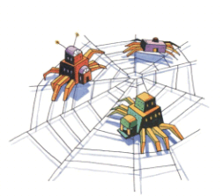
Brief History of Hadoop
Designed to answer the question: “How to process big data with reasonable cost and time?”

Slide 5
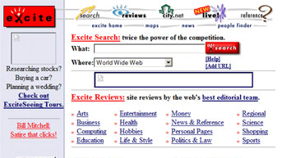
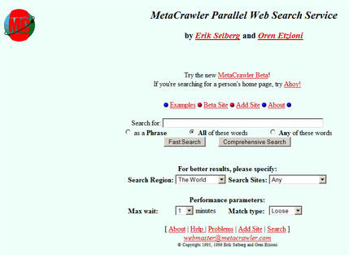
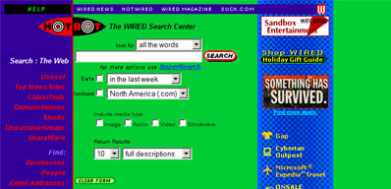
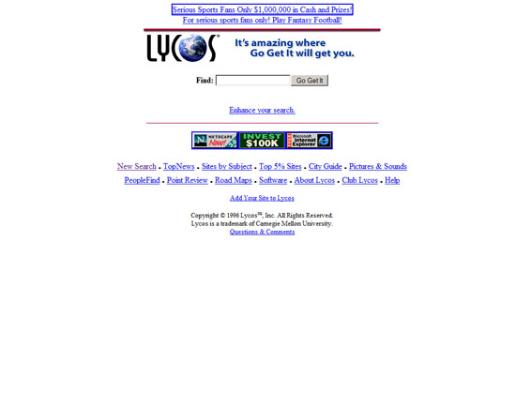
Search engines in 1990s
1996
1996
1996
1997

Slide 6
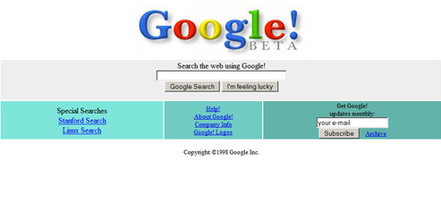

Google search engines
1998
2013

Slide 7
What is Hadoop?
Hadoop:
an open-source software framework that supports data-intensive distributed applications, licensed under the Apache v2 license.
Goals / Requirements:
Abstract and facilitate the storage and processing of large and/or rapidly growing data sets
Structured and non-structured data
Simple programming models
High scalability and availability
Use commodity (cheap!) hardware with little redundancy
Fault-tolerance
Move computation rather than data

Slide 8
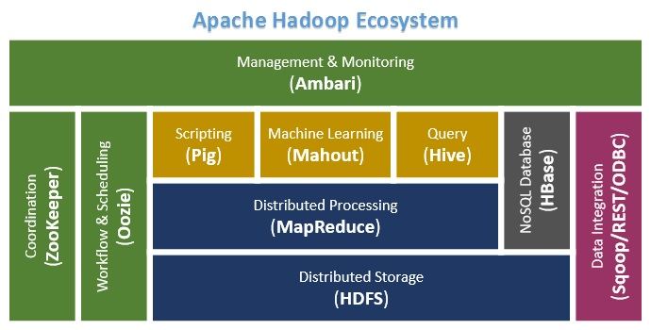

Slide 9
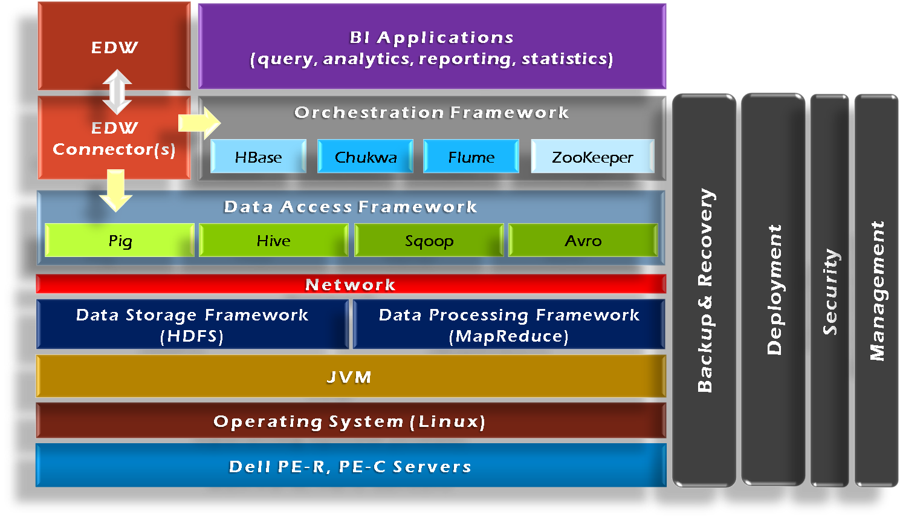
Hadoop Framework Tools

Slide 10
Hadoop’s Architecture
Distributed, with some centralization
Main nodes of cluster are where most of the computational power and storage of the system lies
Main nodes run TaskTracker to accept and reply to MapReduce tasks, and also DataNode to store needed blocks closely as possible
Central control node runs NameNode to keep track of HDFS directories & files, and JobTracker to dispatch compute tasks to TaskTracker
Written in Java, also supports Python and Ruby

Slide 11
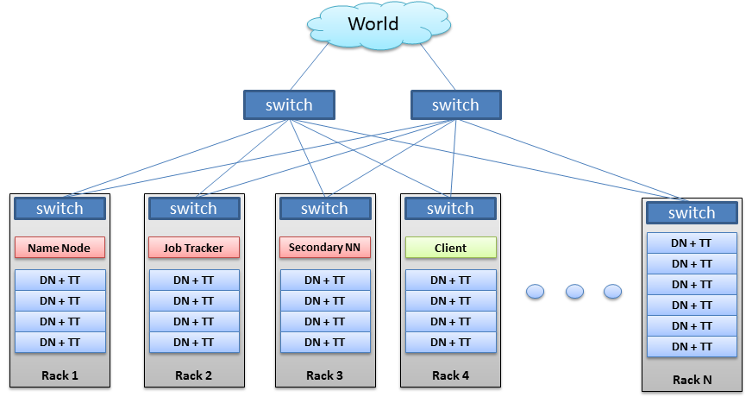
Hadoop’s Architecture

Slide 12
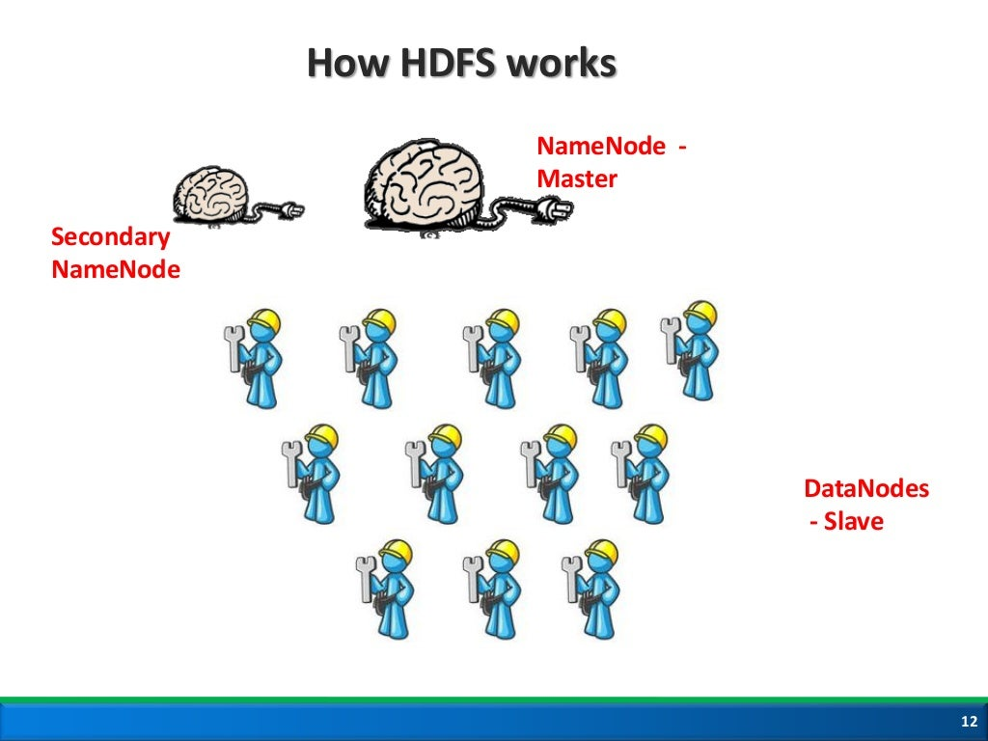

Slide 13
Hadoop’s Architecture
Hadoop Distributed Filesystem
Tailored to needs of MapReduce
Targeted towards many reads of filestreams
Writes are more costly
High degree of data replication (3x by default)
No need for RAID on normal nodes
Large blocksize (64MB)
Location awareness of DataNodes in network

Slide 14
Hadoop’s Architecture
NameNode:
Stores metadata for the files, like the directory structure of a typical FS.
The server holding the NameNode instance is quite crucial, as there is only one.
Transaction log for file deletes/adds, etc. Does not use transactions for whole blocks or file-streams, only metadata.
Handles creation of more replica blocks when necessary after a DataNode failure

Slide 15
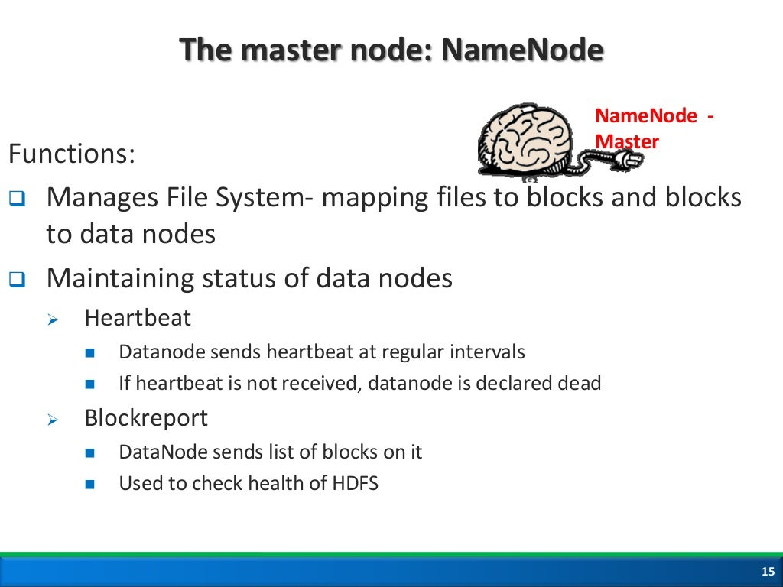

Slide 16
Hadoop’s Architecture
DataNode:
Stores the actual data in HDFS
Can run on any underlying filesystem (ext3/4, NTFS, etc)
Notifies NameNode of what blocks it has
NameNode replicates blocks 2x in local rack, 1x elsewhere

Slide 17
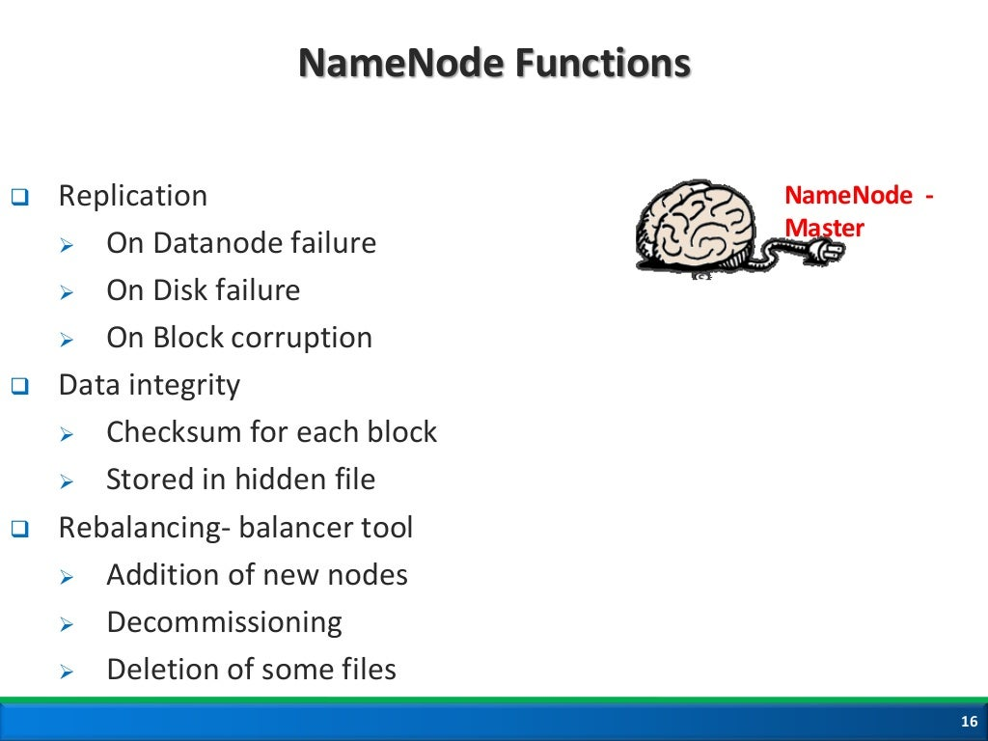

Slide 18
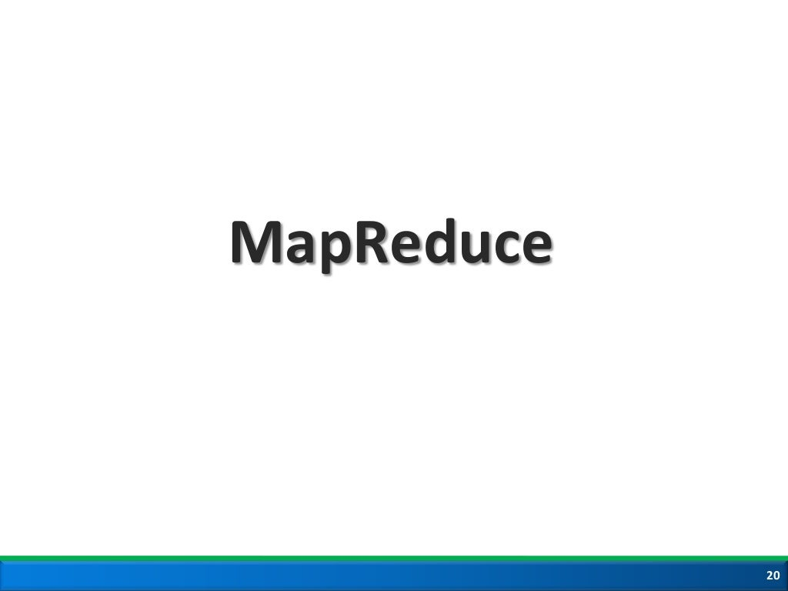

Slide 19
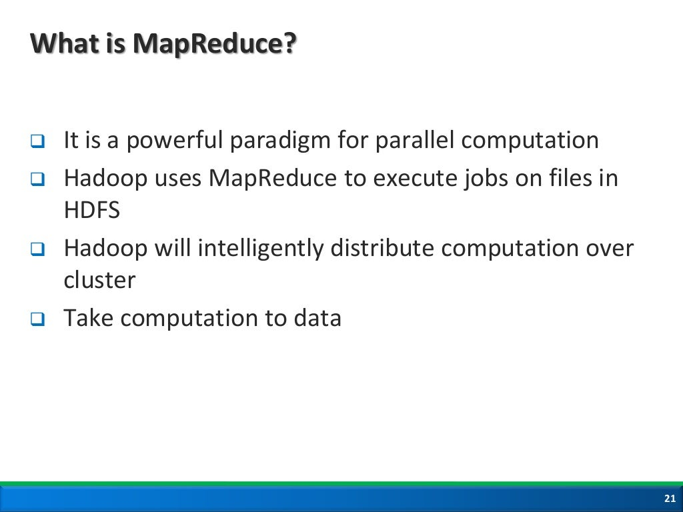

Slide 20
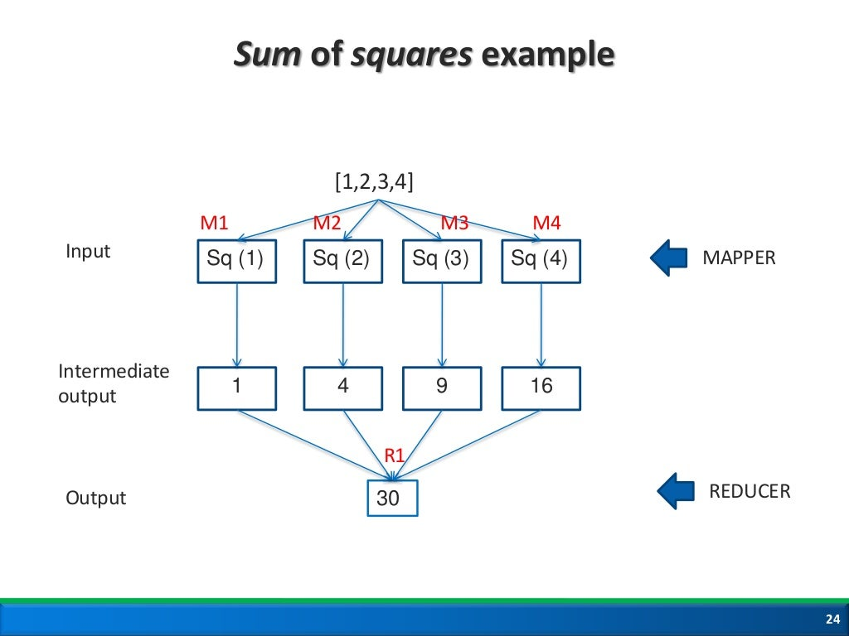

Slide 21
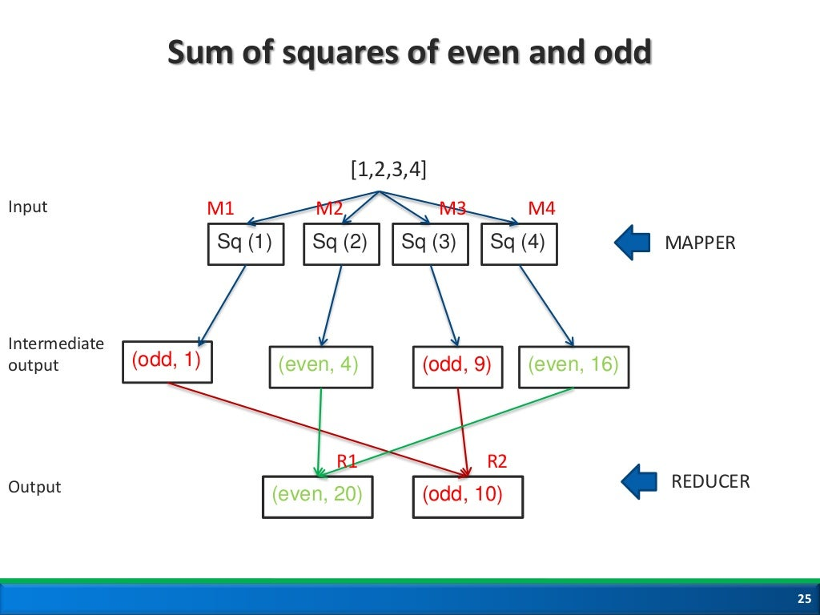

Slide 22
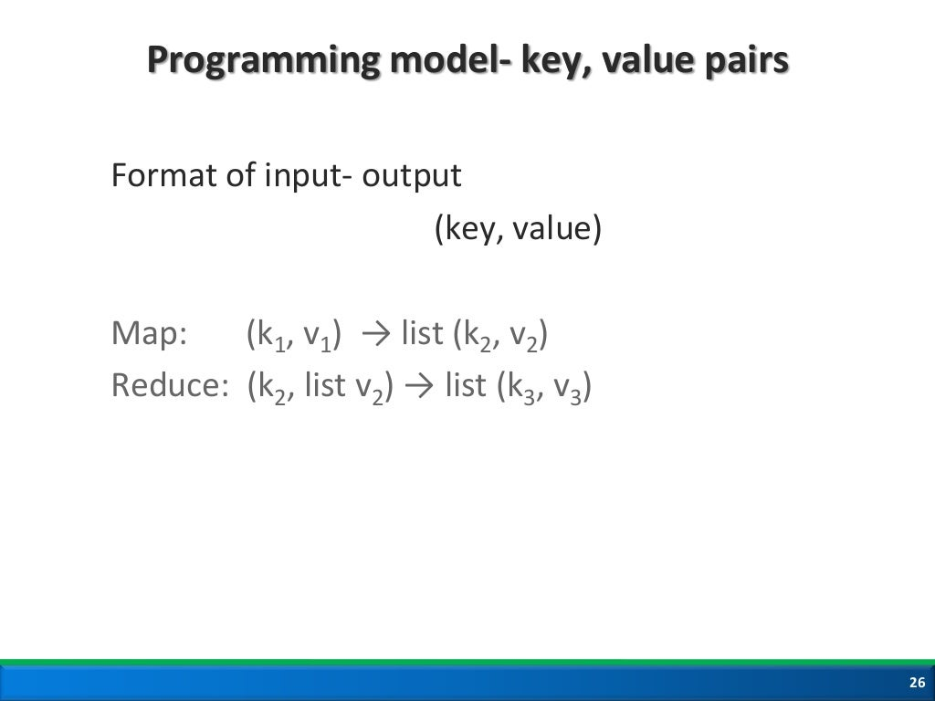

Slide 23
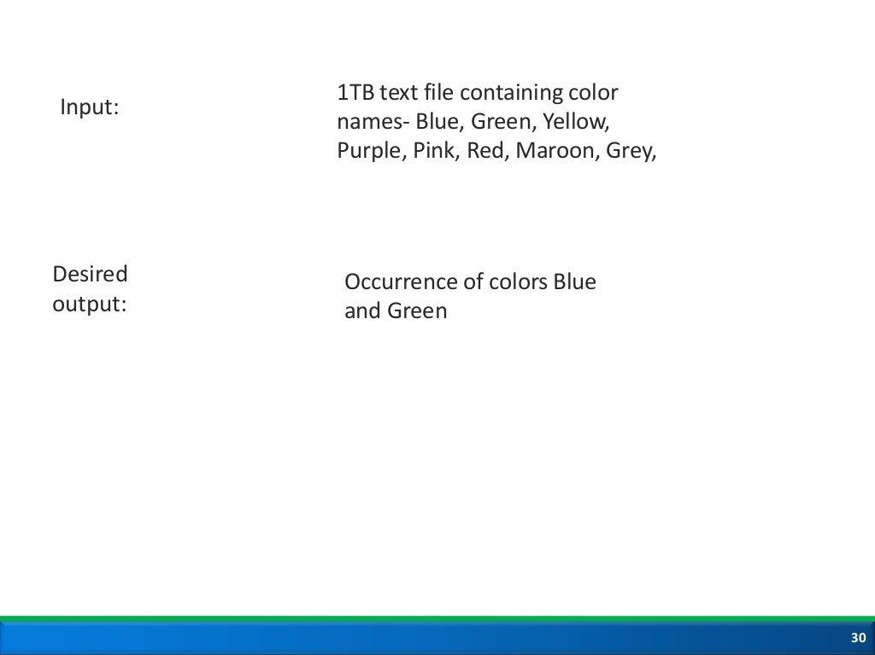

Slide 24
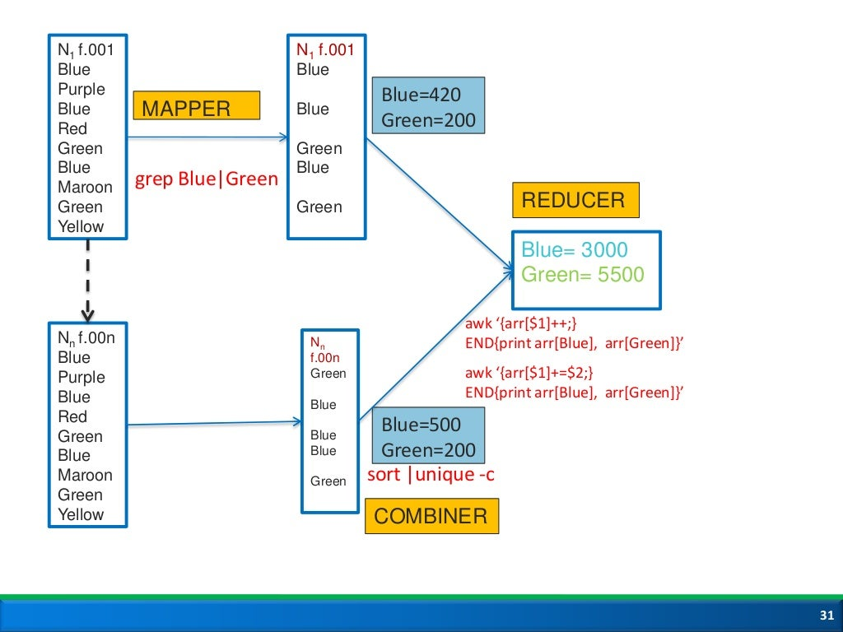

Slide 25
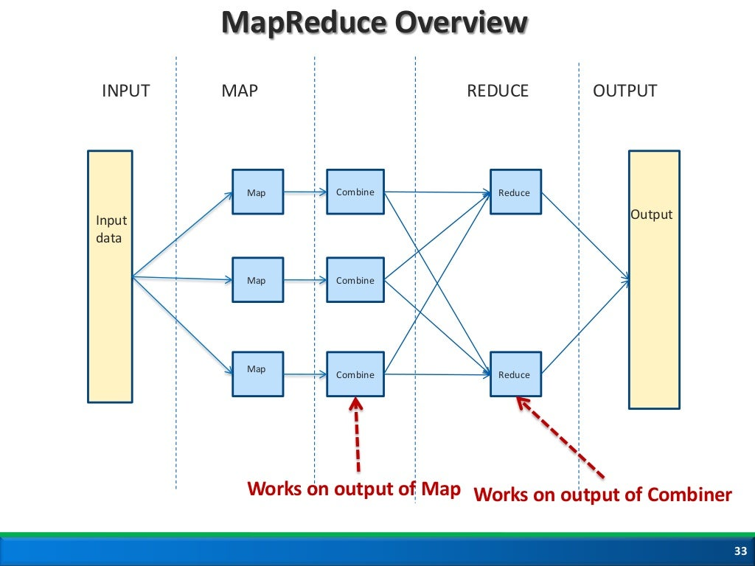

Slide 26
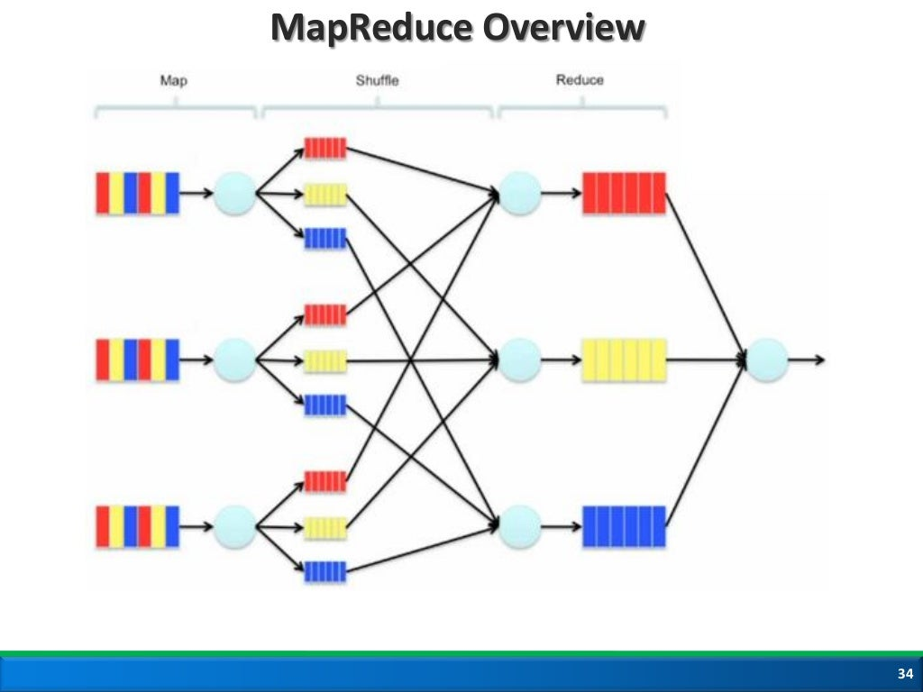

Slide 27
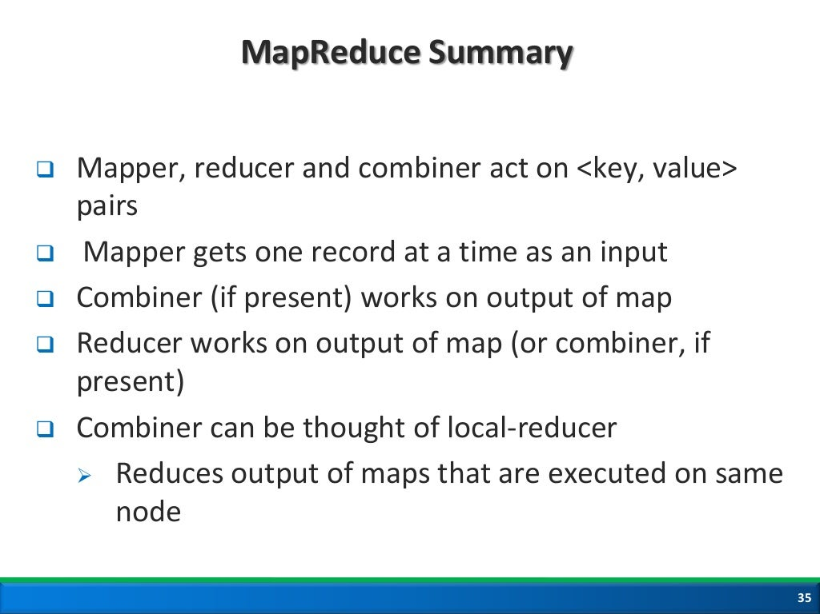

Slide 28
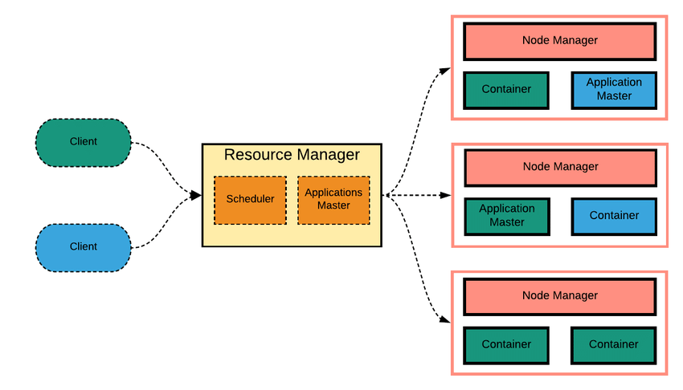
YARN

Slide 29
Multi-tenancy: YARN has allowed access to multiple data processing engines such as batch processing engine, stream processing engine, interactive processing engine, graph processing engine and much more. This has given the benefit of multi-tenancy to the company.
Cluster Utilization: Clusters are utilized in an optimized way because clusters are used dynamically in Hadoop with the help of YARN.
Compatibility: YARN is also compatible with the first version of Hadoop, i.e. Hadoop 1.0, because it uses the existing map-reduce apps. So YARN can also be used with Hadoop 1.0.
Scalability: Thousands of clusters and nodes are allowed by the scheduler in Resource Manager of YARN to be managed and extended by Hadoop

Slide 30
Application Manager is started by the allocation of the Container by the Resource Manager.
Resource Manager and Application Manager register with each other.
The Application Manager does the negotiation of the Container to the Resource Manager.
The Node Manager launches the Container after being notified by the Application Manager.
Execution of Application code is done in the Container.
The Application Manager or Resource Manager monitors the status of the application after being contacted by the client.
Un-Registration of Application Manager is done with Resource Manager after the process is complete.

Slide 31
Hadoop common or Common Utilities
Hadoop common or Common utilities are nothing but our java library and java files or we can say the java scripts that we need for all the other components present in a Hadoop cluster. these utilities are used by HDFS, YARN, and MapReduce for running the cluster. Hadoop Common verify that Hardware failure in a Hadoop cluster is common so it needs to be solved automatically in software by Hadoop Framework.

Slide 32
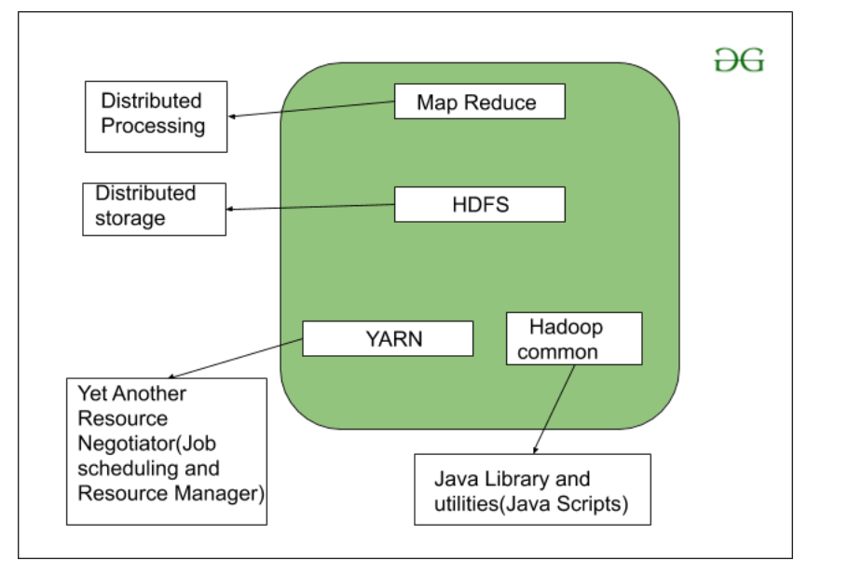

Slide 33
Hadoop Ozone (2020)
Ozone is a scalable, redundant, and distributed object store for Hadoop. Apart from scaling to billions of objects of varying sizes, Ozone can function effectively in containerized environments such as Kubernetes and YARN.
Ozone and HDDS. Ozone is an object store that exposes an S3 API, an Hadoop RPC interface (OzoneFS) and an Container Storage Interface (CSI). OzoneFS is meant to be used as a replacement for HadoopFS and will work on any Hive, Spark or MapReduce job without any code changes

Slide 34
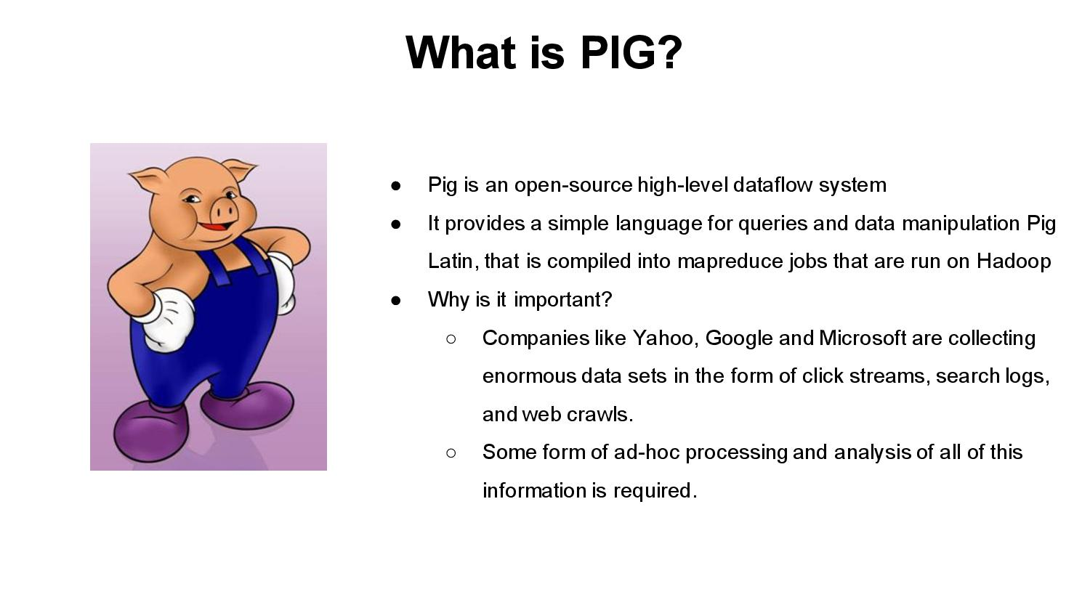

Slide 35
Apache Pig is an abstraction over MapReduce. It is a tool/platform which is used to analyze larger sets of data representing them as data flows. Pig is generally used with Hadoop; we can perform all the data manipulation operations in Hadoop using Pig.
In a MapReduce framework, programs need to be translated into a series of Map and Reduce stages. However, this is not a programming model which data analysts are familiar with. So, in order to bridge this gap, an abstraction called Pig was built on top of Hadoop.
Apache Pig enables people to focus more on analyzing bulk data sets and to spend less time writing Map-Reduce programs. Similar to Pigs, who eat anything, the Apache Pig programming language is designed to work upon any kind of data. That’s why the name, Pig!

Slide 36
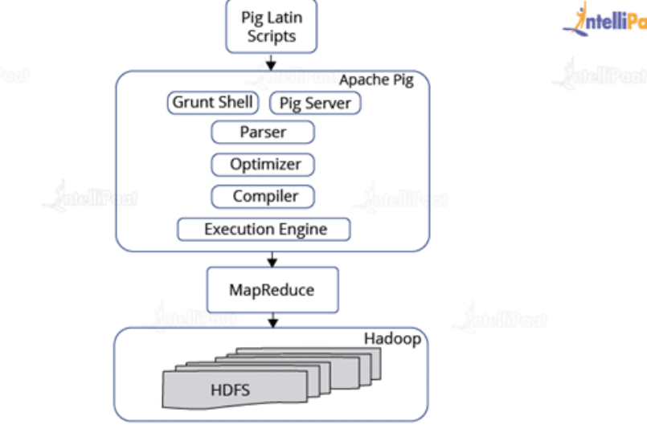

Slide 37
mahout
Apache Mahout is an open source project to create scalable, machine learning algorithms. Mahout operates in addition to Hadoop, which allows you to apply the concept of machine learning via a selection of Mahout algorithms to distributed computing via Hadoop. Mahout's core algorithms include recommendation mining, clustering, classification, and frequent item-set mining.
Algorithms in the Mahout library belong to the subset that can be executed in a distributed fashion and have been written to be executable in MapReduce. Mahout is scalable along three dimensions: It scales to reasonably large data sets by leveraging algorithm properties or implementing versions based on Apache Hadoop.

Slide 38
Features of Mahout
The primitive features of Apache Mahout are listed below.
The algorithms of Mahout are written on top of Hadoop, so it works well in distributed environment. Mahout uses the Apache Hadoop library to scale effectively in the cloud.
Mahout offers the coder a ready-to-use framework for doing data mining tasks on large volumes of data.
Mahout lets applications to analyze large sets of data effectively and in quick time.
Includes several MapReduce enabled clustering implementations such as k-means, fuzzy k-means, Canopy, Dirichlet, and Mean-Shift.
Supports Distributed Naive Bayes and Complementary Naive Bayes classification implementations.
Comes with distributed fitness function capabilities for evolutionary programming.
Includes matrix and vector libraries.

Slide 39
Set up mahout
https://www.ibm.com/docs/en/spectrum-symphony/7.2.0?topic=mapreduce-apache-mahout

Slide 40
hive
Hadoop is a framework to process/query the Big data. Hive is an SQL Based tool that builds over Hadoop to process the data. Hadoop can understand Map Reduce only. Hive process/query all the data using HQL (Hive Query Language) it's SQL-Like Language.

Slide 41
How does Hive work?
Hive was created to allow non-programmers familiar with SQL to work with petabytes of data, using a SQL-like interface called HiveQL. Traditional relational databases are designed for interactive queries on small to medium datasets and do not process huge datasets well. Hive instead uses batch processing so that it works quickly across a very large distributed database. Hive transforms HiveQL queries into MapReduce or Tez jobs that run on Apache Hadoop’s distributed job scheduling framework, Yet Another Resource Negotiator (YARN). It queries data stored in a distributed storage solution, like the Hadoop Distributed File System (HDFS) or Amazon S3. Hive stores its database and table metadata in a metastore, which is a database or file backed store that enables easy data abstraction and discovery.
Hive includes HCatalog, which is a table and storage management layer that reads data from the Hive metastore to facilitate seamless integration between Hive, Apache Pig, and MapReduce. By using the metastore, HCatalog allows Pig and MapReduce to use the same data structures as Hive, so that the metadata doesn’t have to be redefined for each engine. Custom applications or third party integrations can use WebHCat, which is a RESTful API for HCatalog to access and reuse Hive metadata.

Slide 42
The main building blocks of Hive are –
Metastore – To store metadata about columns, partition and system catalogue.
Driver – To manage the lifecycle of a HiveQL statement
Query Compiler – To compiles HiveQL into a directed acyclic graph.
Execution Engine – To execute the tasks in proper order which are produced by the compiler.
HiveServer – To provide a Thrift interface and a JDBC / ODBC server.

Slide 43
Zookeeper
ZooKeeper is a centralized service for maintaining configuration information, naming, providing distributed synchronization and providing group services which are very useful for a variety of distributed systems. HBase is not operational without ZooKeeper.

Slide 44
Sqoop (SQL-to-Hadoop)
Sqoop is a tool designed for efficiently transferring structured data from SQL Server and SQL Azure to HDFS and then uses it in MapReduce and Hive jobs. One can even use Sqoop to move data from HDFS to SQL Server.

Slide 45
Apache Spark
Apache Spark is a general compute engine that offers fast data analysis on a large scale. Spark is built on HDFS but bypasses MapReduce and instead uses its own data processing framework. Common uses cases for Apache Spark include real-time queries, event stream processing, iterative algorithms, complex operations and machine learning.

Slide 46
Flume
Flume is a framework for harvesting, aggregating and moving huge amounts of log data or text files in and out of Hadoop. Agents are populated throughout ones IT infrastructure inside web servers, application servers and mobile devices. Flume itself has a query processing engine, so it’s easy to transform each new batch of data before it is shuttled to the intended sink.

Slide 47
Ambari:
Ambari was created to help manage Hadoop. It offers support for many of the tools in the Hadoop ecosystem including Hive, HBase, Pig, Sqoop and Zookeeper. The tool features a management dashboard that keeps track of cluster health and can help diagnose performance issues.

Slide 48
Conclusion
Hadoop is powerful because it is extensible and it is easy to integrate with any component. Its popularity is due in part to its ability to store, analyze and access large amounts of data, quickly and cost effectively across clusters of commodity hardware. Apache Hadoop is not actually a single product but instead a collection of several components. When all these components are merged, it makes the Hadoop very user friendly.

